Slide 1
Contact Roles
29 August 2011
Notes:
Contact Roles - <number>
Guidewire training materials contain Guidewire proprietary information that is subject to confidentiality and non-disclosure agreements. You agree to use the information in this manual solely for the purpose of training to implement Guidewire software solutions. You also agree not to disclose the information in this manual to third parties or copy this manual without prior written consent from Guidewire. Guidewire training may be given only by Guidewire employees or certified Guidewire partners under the appropriate agreement with Guidewire.

Slide 2
Lesson objectives
By the end of this lesson, you should be able to:
  Describe the ways in which contacts are categorized
  Describe and configure contact roles
  Configure contact role type constraints
  Configure entity role constraints
  This lesson uses the notes section for additional explanation and information.
  To view the notes in PowerPoint, choose View→Normal or View→Notes Page.
  If you choose to print the notes for the lesson, be sure to select “Print hidden slides.”
Notes:
Contact Roles - <number>

Slide 3
Lesson outline
Contact roles
Categorizing contact
Contact role configuration
Contact role type constraints
Entity role constraints
Notes:
Contact Roles - <number>

Slide 4
Contact roles
Auto Claim
036-22-934712
Workers' Comp Claim
772-12-9000
OmniTech Inc.
- Insured (policy)
Ellen Lopez
- Insured (policy)
- Reporter (entire claim)
- Claimant (exposure 1)
Tommy Duke
- Claimant (exposure 1)
Matt Sawyer
- Doctor (entire claim)
Matt Sawyer
- Doctor (entire claim)
Notes:
Contacts - <number>
Whenever a contact is associated to a claim, the contact has one or more roles on the claim. Each role identifies a relationship between the contact and the claim. Each role can be “related to” the claim or one of its parts. This relationship designates if the contact has this role for the entire claim, for the policy, for a specific exposure, or for a specific incident.
Keep in mind that every contact object in ClaimCenter is unique. It is possible for a single person to be a contact on multiple claims. (In the example above, Matt Sawyer is a doctor for the auto claim and the workers' comp claim.) In this case, there are two unique objects corresponding to the same person. Fields within one object may have the same values as or different values than the corresponding fields in the other object. For example, Matt Sawyer's address may be the same in both contact objects, but his "okay to contact" field may be different. (It could be okay to contact him for the workers' comp claim but not okay to contact him for the auto claim.)
(continued)

Slide 5

(Notes only slide)
Notes:
Contacts - <number>
ClaimCenter has a "role constraint" feature which adds additional business logic around contact roles. Role constraints can be used to:
Identify which contact subtypes can hold a given role (such as a contact must be of subtype "person vendor" to hold to role of inspector")
Identify if there must be a contact on the claim with a given role (such as every claim must have a "reporter" and at least one "claimant")
Identify the cardinality of the claim to the role (which identifies if there can only be one contact with that role for a given claim, such as "reporter", or whether there can be many contacts with that role for a given claim, such as "claimants")
Identify whether a contact with a given role can be related to a given entity (such as the role of "driver", which can be related to a vehicle but cannot be related to an exposure)

Slide 6
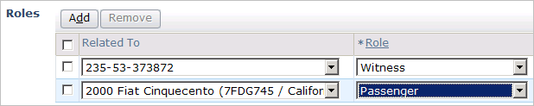
Roles in the user interface
Claim
235-53-373872
witness
Helen
Nixon
passenger
Incident
2000 Fiat
(entire claim)
Notes:
Contacts - <number>
Recall that a contact may have more than one role and that each role is held in relation to the entire claim or to a specific exposure, incident, or policy.
The default relationship for each role is the entire claim, which appears in the Owner dropdown as the claim number.
In the example above, Helen Nixon:
Has the role of witness for the entire claim.
Has the role of passenger only for the 2000 Fiat incident.

Slide 7
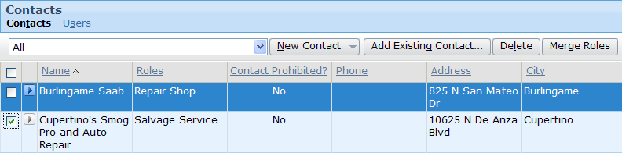
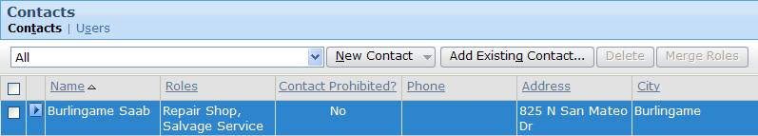
Merging roles on a claim
Merge roles button has two effects
  Surviving (selected) contact received all roles of clicked contacts
  Clicked contacts removed from claim
Can only merge if contact allowed to have all selected roles
Notes:
Contacts - <number>
The Contact list has a Merge Roles button, which lets you collapse multiple contacts with potentially redundant role information into a single contact. One contact (the "survivor") remains on the contact and inherits all roles of the other selected contacts. The other selected contacts are then removed from the claim. To merge roles:
Select the "survivor" contact by clicking that row. (Recall that the selected row of a listdetail view appears with a blue background.)
Select one or more other contacts by checking the checkbox. These contacts will be removed from the claim, and their roles added to the selected contact from step 1.
Click Merge Roles. The contacts selected in step 2 are removed from the claim, and any roles that these removed contacts had are added to the "survivor" contact.

Slide 8
Lesson outline
Contact roles
Categorizing contact
Contact role configuration
Contact role type constraints
Entity role constraints
Notes:
Contact Roles - <number>

Slide 9

Contact categorization
By Subtype
By Role
Contact
with role "reporter"
Company
with role "claimant"
with role "driver"
Auto Towing
Auto Repair
Contact objects are categorized in two ways
  By subtype
  By role
Each categorization offers different functionality and involves different types of configuration
Notes:
Contact Roles - <number>

Slide 10
Categorization by subtype
Contact
Primary Address
Primary Phone
Primary Address
Primary Phone
Employees
Company
Primary Address
Primary Phone
Employees
AutoTowLicense
Primary Address
Primary Phone
Employees
AutoRepairLicense
Auto Towing
Auto Repair
Contact entity is subtyped
  Fields inherited in hierarchical manner
  Mirrors behavior of contacts in real world
Subtype categories reflect data gathered about a contact
Notes:
Contact Roles - <number>

Slide 11
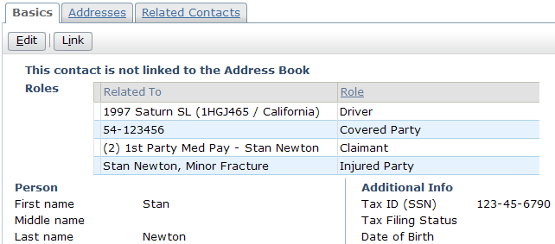
Categorization by role
"reporter"
"claimant"
"driver"
Role describes relationship between contact and claim
  Each contact must have at least one role
  Each role is "owned by" entire claim or one of its sub-objects (policy, exposure, incident, and so on)
Notes:
Contact Roles - <number>
Role configuration involves specifying how roles and the "Related To" entities interact
For example, a claim must have exactly one reporter and can have zero to many claimants

Slide 12
The contact role data model
Claim
Contacts
Stores fundamental information about contact
Links contact to a claim and its role(s) on the claim
ClaimContact
Contact
Person
Company
Venue
Roles
ClaimContact
RoleOwner
ClaimContact
Role
For each role, identifies owner (claim or subobject)
Identifies role(s) contact has on claim
Notes:
Contact Roles - <number>
In the base application, matters and evaluations can also be role owners. (For example, a contact could be the "assessor" for an evaluation or the "primary defense attorney" for a matter.)
Claim.RoleOwners is an array of all Role Owners.
Categorization "by subtype" occurs within the Contact entity. When a contact is created, it is created as one of the subtypes, which in turn categorizes the kind of contact it is.
Categorization "by role" occurs within the ClaimContactRole and ClaimContactRoleOwner entities. When a contact is associated with a claim, it must have at least one role (which is linked to the contact through the ClaimContact entity), and this role has a role owner (the entity for which the contact's role is relevant).

Slide 13
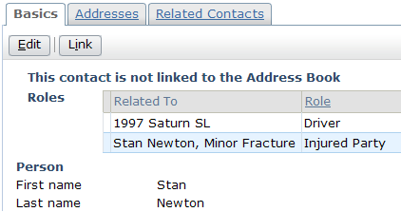
The contact data model in the UI
ClaimContact
Contact
Person
Company
Venue
ClaimContact
RoleOwner
ClaimContact
Role
Notes:
Contact Roles - <number>
The example above is a visual illustration of the four main entities in the "contact data model".
The base contact information is stored inside one of the subtypes of contact.
The contact has one or more roles on the claim. These are stored in ClaimContactRole objects and appear in the user interface in the Role column of the Roles list. Note that the relationship between ClaimContact and ClaimContactRole is one-to-many, which manifests itself in the user interface as a single contact with a list of one to many roles.
Each role that the contact holds has a "Related To" entity, also known as the role owner. These are stored in ClaimContactRoleOwner objects and appear in the user interface in the Related To column of the Roles list. Note that the relationship between ClaimContactRole and ClaimContactRoleOwner is one-to-one. Each role is owned by only one object.
Finally, the ClaimContact object links all of the information together and attaches it to the claim.

Slide 14
Intersection of roles and subtypes
Doctor
Person
role:
primary doctor
role:
primary doctor
Doctor
Company
role:
physical therapist
role:
primary doctor
Two contacts of the same subtype could exist on the same claim with different roles (and this is quite common)
Typically, two contacts of different subtypes cannot have the same role
Notes:
Contact Roles - <number>
Roles and subtypes classify contacts in different ways. This raises the question of whether or not you can have two contacts which have the same subtype but different roles and vice versa.
It is common for two contacts to have the same subtype but different roles. For example, two contacts of subtype Doctor could be associated with a claim, one with the role of primary doctor, the other with physical therapist. (This could occur if a claim involved an injury in which the primary doctor referred the injured party to a physical therapist.)
As a general practice, each role can only be assigned to contacts of a single subtype. Therefore, it is rare to have two contacts of different subtype with the same role. (The one exception to this in the base application is the role "claimant". A "claimant" is always of subtype person, except when it is on an exposure, in which case it can also be of subtype company. So a claimant must be either a Person or, if being assigned to an exposure, a Person or Company.)
One thing to keep in mind is that a contact has a subtype inherently, but a contact has a role only with relationship to a given claim. A contact of subtype adjudicator is always of subtype adjudicator, regardless of the claims it may or may not be associated to. A contact with role "arbitrator" on a given claim is (potentially) an arbitrator only for that claim and only by virtue of being associated with that claim.

Slide 15
Lesson outline
Contact roles
Categorizing contact
Contact role configuration
Contact role type constraints
Entity role constraints
Notes:
Contact Roles - <number>

Slide 16
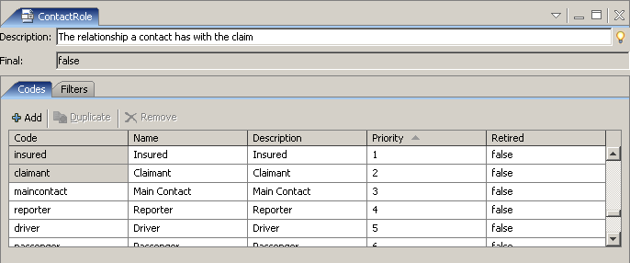
Contact roles
The ContactRole typelist lists all contact roles
  To create a new role, add a typecode to the typelist
Notes:
Contact Roles - <number>

Slide 17
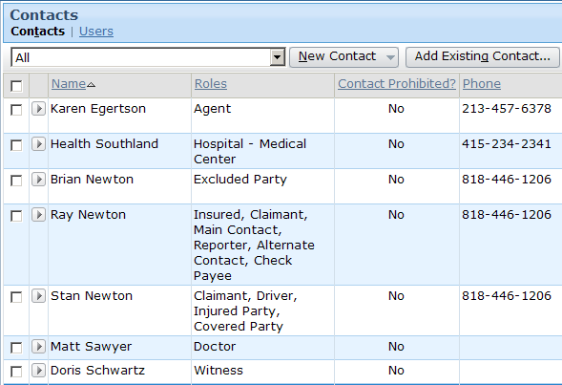
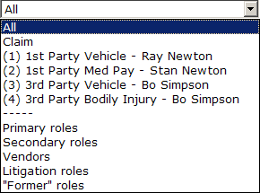
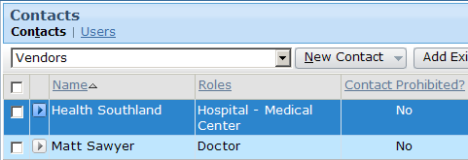
The contacts list view filter
entity
filtering
contact role
category
filtering
Notes:
Contact Roles - <number>
The contacts list view has a filter in the toolbar that can be used to filter the contacts listed in the list. There are two types of filters:
Entity filters let the user select the claim or one of its exposures. The list then contains only contacts who have a role that is owned by the selected entity.
Role category filters let the user select a role category. The list then contains only contacts that have a role that fits the selected category.
Roles are assigned to categories through the ContactRoleCategory typelist, which is discussed on the next slide.

Slide 18
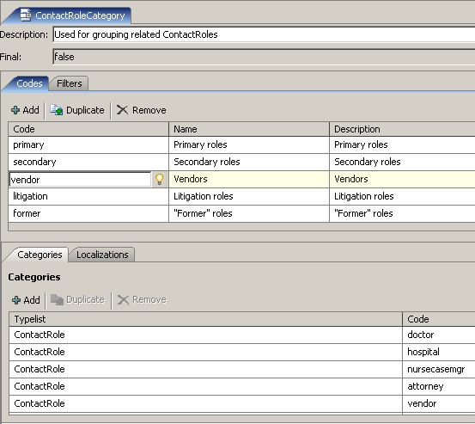
Contact role categories
This typelist exists purely for filtering the contacts list view
Notes:
Contact Roles - <number>
To assign a role to a given category:
Go to the ContactRoleCategory typelist.
Select the desired category typecode.
Add the desired role to the Categories tab.

Slide 19
Role constraints
role: driver
role:
primary
doctor
role: driver
Attorney
An attorney who's the primary doctor?
role: driver
Three people were driving the car?
Role constraints prevent users from assigning roles to contacts in a manner that does not make business sense
Notes:
Contact Roles - <number>

Slide 20

Two types of role constraints
role:
primary
doctor
Doctor
role: claimant
exposure
(exactly 1)
role:
primary
doctor
Attorney
role: claimant
policy
(0)
Contact role type constraint
Which subtypes can have this role?
Entity role constraint
Which types of entity can own the role?
How many contacts can you have with role?
Notes:
Contact Roles - <number>
A contact role type constraint can be thought of as a "which subtype" constraint. It identifies the subtype for which a given role is allowed. In the example above, the role primary doctor can be held by anyone of the subtype doctor but not the subtype attorney.
An entity role constraint can be thought of as both a "which owner" constraint and a "how many" constraint. It identifies which entities can be the owner of a role, and how many contacts can be associated with that entity with that role (exactly one, at least one, at most one, or unlimited). In the example above, an exposure (for a non-workers' comp claim) must have exactly one claimant. A policy cannot have any claimants.

Slide 21
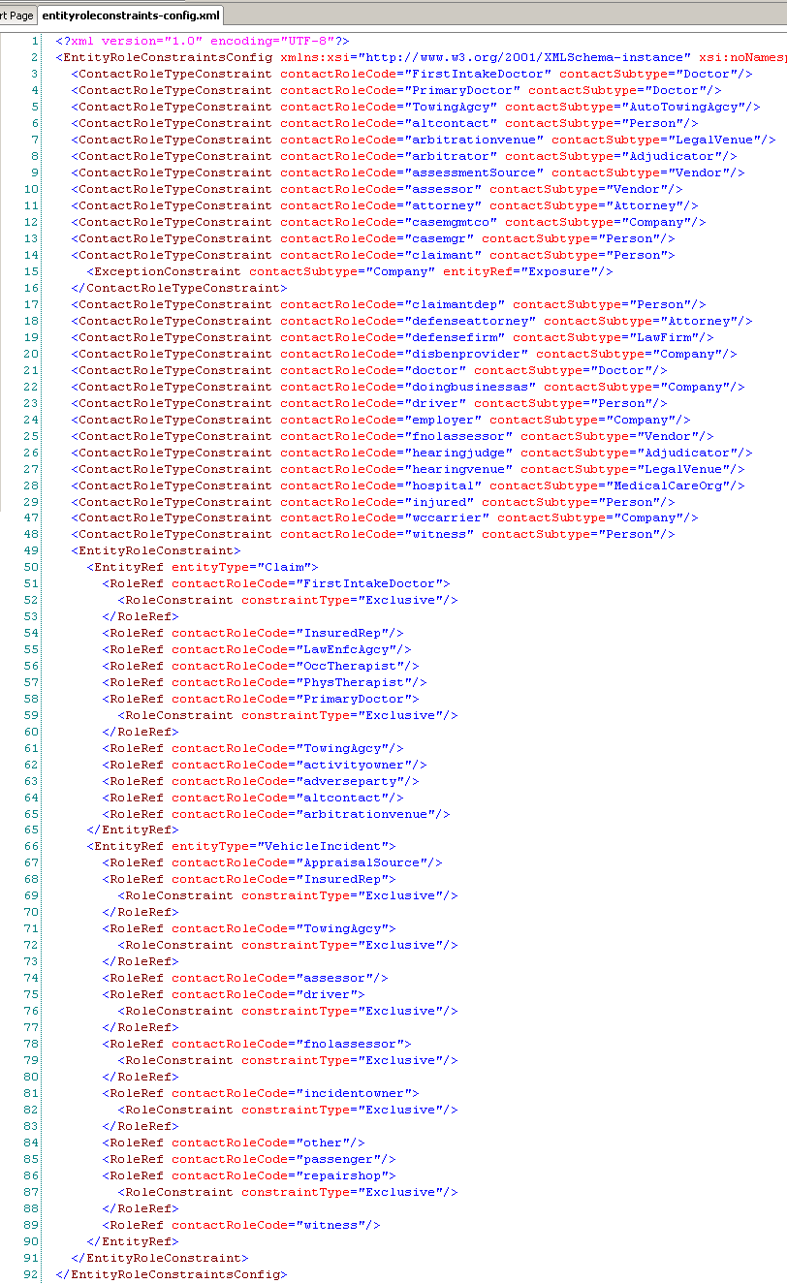
Specifying role constraints
Both type are specified in entityroleconstraints-config.xml
role:
primary
doctor
Doctor
Contact role type constraints
role: claimant
exposure
(exactly 1)
Entity role constraints
Notes:
Contact Roles - <number>
The following sections of this lesson discuss how to configure each type of role constraints.

Slide 22
Lesson outline
Contact roles
Categorizing contact
Contact role configuration
Contact role type constraints
Entity role constraints
Notes:
Contact Roles - <number>

Slide 23
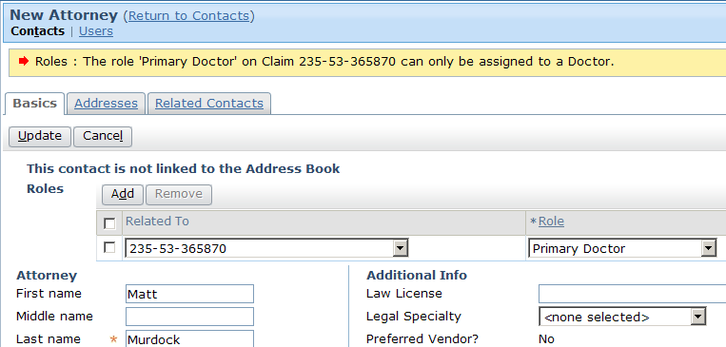
Contact role type constraints in the user interface
role:
primary
doctor
Attorney
Prevents user from assigning given role to contact of given subtype
  Role appears in dropdown, but attempts to save contact fail
Notes:
Contact Roles - <number>
The base application contains a role constraint that states "The role of primary doctor can only be assigned to a contact of subtype 'doctor'." In the screenshot above, the user is attempting to assign the role of primary doctor to a contact of subtype 'attorney'. The constraint prevents the role assignment from occurring, and the error message details the reason.

Slide 24
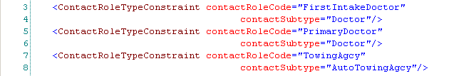
Contact role type constraint configuration
AutoTowing
Agcy
Doctor
role: first intake doctor
primary doctor
role: towing agency
Identifies a role (such as "PrimaryDoctor") and a subtype for which the role is valid (such as "Doctor")
  Given subtype may have multiple roles
  In most cases, given role should be permitted for only one subtype
Notes:
Contact Roles - <number>
Typically a contact role should have only one contact subtype but in the base application there is one exception:
<ContactRoleTypeConstraint contactRoleCode="claimant" contactSubtype="Person">
<ExceptionConstraint contactSubtype="Company" entityRef="Exposure"/>
</ContactRoleTypeConstraint>
This is the special case that occurs only once in the base application. In the example above, claimant is always of subtype person, except when on exposure, it can also be of subtype company. So a claimant must be either a Person or, if being assigned to an exposure, a Person or Company.

Slide 25
Lesson outline
Contact roles
Categorizing contact
Contact role configuration
Contact role type constraints
Entity role constraints
Notes:
Contact Roles - <number>

Slide 26
Entity role constraints
For a given type of "related to" entity, a role can be:
  Not allowed
  Unlimited
  Limited to at least one, at most one, or exactly one contact
reporter
claimant
driver
claim
(exactly 1)
policy
(0)
claim*
(0)
policy
(0)
claim, exp., policy, injury in., property in.
(0)
exposure
(0)
incident
(0)
exposure
(exactly 1)
incident
(0)
vehicle in.
(up to 1)
Notes:
Contact Roles - <number>
With regards to the "reporter" role:
A claim must have exactly one reporter.
A policy, exposure, or incident cannot have a reporter.
With regards to the "claimant" role:
An exposure must have exactly one claimant.
A claim*, policy or incident cannot have a claimant.
With regards to the "driver" role:
A claim, policy, exposure, injury incident or property incident cannot have a driver.
A vehicle incident can have up to one driver.
*The behavior of the claimant constraint actually varies based upon the loss type. For auto, property, and general liability claims, the claimants do not exist at the claim level. You cannot add a contact as a claimant until you have exposures, and the "claimant" contacts are owned by the exposures, not by the claim itself. For workers' comp claims, there is always a single claim, regardless of the number of exposures. Therefore, a workers' comp claim can (and must) own a contact with the role of claimant.

Slide 27
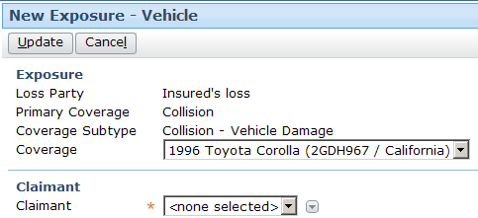
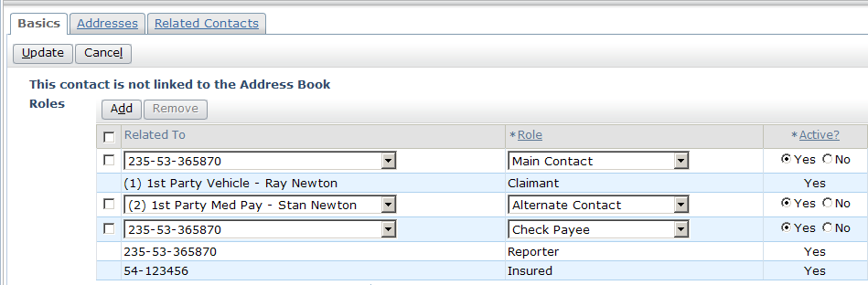
Entity role constraints in the UI (1)
claimant
exposure
(exactly 1)
If role is required:
  Contact must be specified during object creation
  Role can be shifted between contacts, but must always exist
Notes:
Contact Roles - <number>
In the example above, the role "claimant" is required for the exposure entity. (Every entity must have exactly one claimant.) Therefore:
During the creation of the exposure, the Claimant field is required. The selected contact is added to the claim with the role "claimant" for the given exposure.
Once created, the row in the Roles list view for the exposure claimant remains read-only, even if the list view itself is in edit mode.
From the Parties Involved screen, you cannot modify a role that is required (such as the "Reporter" role shown above). However, there may be other places in the application where you could move the role from one contact to another. (For example, the Loss Details screen has a "Reported By" widget that can be used to select a different contact to have the role of reporter.)

Slide 28
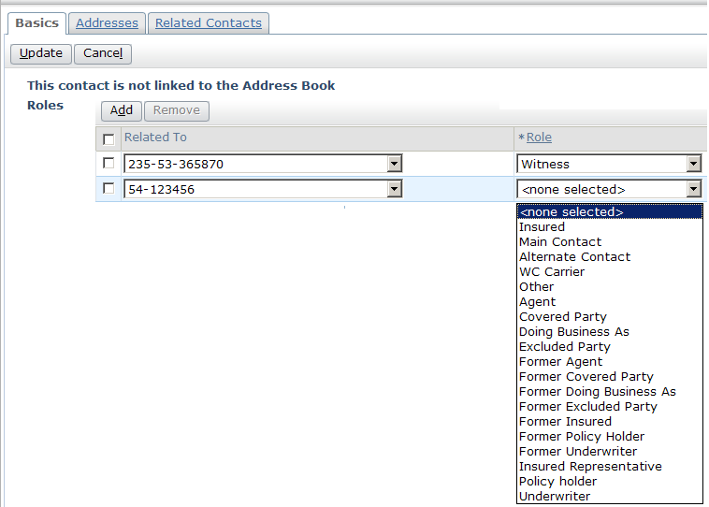
Entity role constraints in the UI (2)
(policy)
claimant
policy
(0)
If role is not allowed:
  Does not appear in dropdown once Related To entity is selected
Notes:
Contact Roles - <number>
In the example above, the role "claimant" is not allowed for the policy entity. (Every entity must have no claimants.) Therefore:
When you select a policy in the Related To dropdown, the "Claimant" role is hidden from the Role dropdown.
If you select "Claimant" from the Role dropdown and then select a policy in the Related To dropdown, the Role dropdown is reset to "none selected".

Slide 29
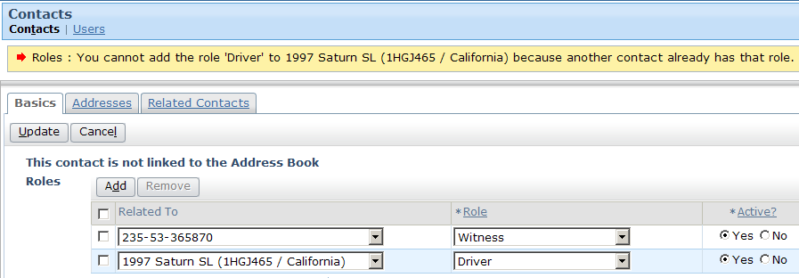
Entity role constraints in the UI (3)
vehicle incident
(up to 1)
driver
If role is limited to at most one contact and existing contact has role, then error message displays when user attempts to give role to additional contact
Notes:
Contact Roles - <number>
In the example above, there is already a contact associated with the claim with the role of "driver" for the 1997 Saturn SL incident. Therefore, a second contact cannot be given that same role on that same incident.

Slide 30
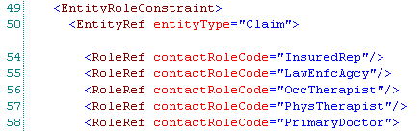
Entity role constraint configuration
(unrestricted)
Entity role constraint lists type of entity and roles allowed for that entity
  RoleRef (without any child tags) identifies that any number of contacts (including 0) can have role on instance of that entity
  For example, claim can have 0 to many physical therapists
Notes:
Contact Roles - <number>

Slide 31

Entity role constraint configuration
(restricted)
Role constraint modifies "0 to many" default cardinality
Can be set to:
  Exclusive - At most one (0 or 1)
  Required - At least one (1 to many)
  Prohibited - None (0)
Notes:
Contact Roles - <number>
In the example above, a claim is not required to have a FirstIntakeDoctor, but it can have up to one FirstIntakeDoctor.

Slide 32
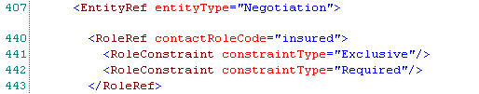
Role refs with multiple role constraints
A RoleRef can have multiple role constraints, which typically occurs when combining...
  Exclusive (at most one), and
  Required (at least one)
...to require exactly one contact with the role
Notes:
Contact Roles - <number>
In the example above, a Negotiation must have exactly one contact with the role insured.

Slide 33
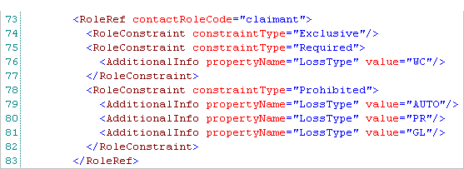
Conditional role constraints
RoleConstraint can have AdditionalInfo child, which specifies entity field and value
  Constraint applies only when field has that value
Notes:
Contact Roles - <number>
In the example above, the role "claimant" is exclusive and required for a claim if the claim's loss type is "WC" (workers' comp). This is because all exposures in a workers' comp claim have a single claimant, and it makes the most sense to track the claimant at the claim level. The role "claimant" is prohibited for a claim if the claim's loss type is "AUTO", "PR" (property), or "GL" (general liability). This is because each exposure in these types of claims can have a different claimant. Therefore, the "claimant" role is owned by the exposures and is not owned at the claim level itself. (If it were owned at the claim level, a user could create a claimant that was not assigned to any exposure, which users shouldn't be allowed to do.)
If a RoleRef has any conditional RoleConstraints, then it must have a "default" unconditional RoleConstraint as well. This is required for internal processing. The unconditional RoleConstraint should be at the most relaxed level possible, which typically is "ZeroToMany". In the example above, line 74 is the default RoleConstraint. If the instance of ClaimCenter has only four possible loss types (WC, AUTO, PR, and GL), then the role constraint will never be enacted. Nevertheless, an unconditional role constraint is still required.

Slide 34


Contact role functions
For "Related" entities, function created for each role entity can own
Appears in data dictionary like a field, but:
  Always singular (even when many contacts can have the role)
  Sometimes written with a lowercase initial letter
  Always a virtual property, not a table column
Returns the contact with the role "reporter" for the claim
Returns the set of persons with the role "witness" for the claim
Notes:
Contact Roles - <number>

Slide 35
Review: Steps to create a new contact role
Edit ContactRole typelist with new role
Edit ContactRoleCategory typelist
  Only if you want this role filterable in parties involved listview entries
Edit entityroleconstraints-config.xml
  Add contact role type constraint to restrict type of contact allowable for this role
  Add entity role constraints to enable role on entities
    Add further constraints to make role exclusive, required, or prohibited

Slide 36
Lesson objectives review
You should now be able to:
  Describe the ways in which contacts are categorized
  Describe and configure contact roles
  Configure contact role type constraints
  Configure entity role constraints
Notes:
Contact Roles - <number>

Slide 37
Review questions
What is the ContactRoleCategory typelist used for?
Acme Insurance has requirements around contacts who are inspectors. For each requirement, identify if this could be implemented through a subtype, a contact role type constraint, or an entity role constraint:
  A property incident can have at most one inspector, but it is not required.
  An inspector must have a license, and Acme must know the date the license was issued.
  You cannot assign an inspector to a policy.
  The inspector role cannot be assigned to a contact whose subtype is doctor or lawyer.
The Claim entity has a listing in the data dictionary called "reporter". It is not a data field. What is it?
Notes:
Contact Roles - <number>
Answers
1. The typelist is used for the contact filter which appears at the top of the Contacts list.
2. a) Entity role constraint
b) Subtype
c) Entity role constraint
d) Contact role type constraint
3. It is a derived property that returns the contact who has the role "reporter" on the claim.

Slide 38
Notices
Copyright © 2001-2011 Guidewire Software, Inc. All Rights Reserved.
Guidewire, Guidewire Software, Guidewire ClaimCenter, Guidewire PolicyCenter, Guidewire BillingCenter, Guidewire Reinsurance Management, Guidewire ContactManager, Guidewire Vendor Data Management, Guidewire Client Data Management, Guidewire InsuranceSuite, Guidewire ContactCenter, Guidewire Studio, Gosu, Deliver Insurance Your Way, and the Guidewire logo are trademarks or registered trademarks of Guidewire Software, Inc. in the United States and/or other countries.
This material is Guidewire proprietary and confidential. The contents of this material, including product architecture details and APIs, are considered confidential and are fully protected by customer licensing confidentiality agreements and signed Non-Disclosure Agreements (NDAs).
This file and the contents herein are the property of Guidewire Software, Inc. Use of this course material is restricted to students officially registered in this specific Guidewire-instructed course, or for other use expressly authorized by Guidewire. Replication or distribution of this course material in electronic, paper, or other format is prohibited without express permission from Guidewire.
    Guidewire products are protected by one or more of the following patents: U.S. Patent No. 7,885,831; U.S. Patent No. 7,788,296.
Notes:
Introduction to Guidewire Configuration - <number>

